Slide 1


Team Invovled
Dileep Kadhati
Jignesh Chovatia
Shashank Singh
Praveen Desu
Nagaraja Yellarthy

Slide 2


Efficient Single Page Application
Delivered
Enable the Single Page Application to operate efficient even with less internet speed
Efficient Single Page Application
Increased Customer Trust in using the Organization application as the application operate efficiently
Improved Customer overall experience with the Single Page application
Business Requirement
The Single Page application that is being built for the organization must be able to operate efficiently even when Internet connectivity is not available at the highest speeds to meeting the business demand
Solution 1
To have a Caching mechanism within the client implementation. Cache the results of calling the Backend for Frontend services so as to reduce unnecessary round trips to the server.
Solution 2
To have a local storage DB to store recurrent information like customer meta info, purchase-related info e.tc (no sensitive information such credit card, Social security etc) and we can use Index DB to store complex data to reduce the back-end calls.
Improved customer efficiency due to enhanced Application
Higher Value Realization from Investments
Notes:
https://www.happiestminds.com/casestudies/Self-Knowledge-Assembly-Platform-Transforms-Customer-Service.pdf

Slide 3

Context Architecture
Clients
Single Page Application
Cache
Application Server
Database

Slide 4
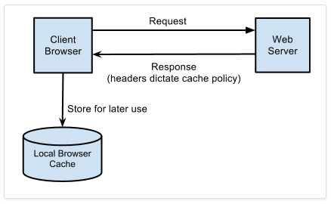
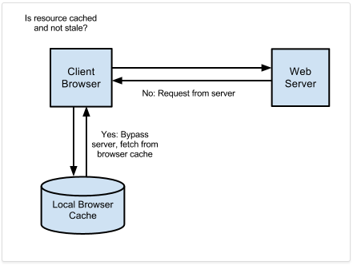
Container Diagram
The simplest type of near cache is a globally scoped variable containing a hashtable data structure - something that is easily supported by JavaScript for Single Page Application or Java or Swift for Native Mobile Applications. In iOS, Core Data or Property Lists can easily be used to store cached data locally. However, that’s not always the right solution – you may need more to store more complex data structures. In this case, SQLite can be used on both iOS and Android as a fast, local structured data store.
The benefit of a Near Cache is that it reduces the total number of times you must call a Backend for Frontend to retrieve repeated information. The drawback is that you must now manage the lifetime of the information in the cache to avoid it becoming stale, which can add complexity to your application code.

